Slide 1

AGM
16 September 2026

Slide 2
1. Chairperson’s welcome and introductions – Ben Lockwood, Chair of the CMO Board
2. Chairperson’s Introduction to the meeting and Approval of 24/25 draft AGM minutes – Ben Lockwood
3. Members Vote
4. Presentation of Charity Company Accounts and Independent Examiners Report 25/26 – Presented by Maria Hadfield - CEO
5. Members Vote
6. Appointment of External Examiner – Maria Hadfield
7. Members Vote
8. Presentation of Trust Accounts and FAQ – Maria Hadfield, Interim CEO
9. Close of formal proceedings – Ben Lockwood

Slide 3
Approval of the 2024/25 AGM Minutes
Any questions/clarifications?
Propose for approval
Directors Vote
Members vote

Slide 4
Purpose of the AGM
  The Company shall hold an Annual General Meeting each calendar year, to be held at such time and place as the Board decides subject to Article 11.The business of the Annual General Meeting shall be:
    to (re-)appoint Directors (if necessary);
    to receive the annual ' report of the Board;
    to consider the accounts and the auditors’ report;
    to appoint the auditors (if necessary); and
    to transact any other business specified in the notice convening the meeting.

Slide 5
Chilmington Management Organisation (CMO)
The CMO is a Charity set up as part of the S106 agreement.
The principal aims and related activity areas of the Trust are defined in the charitable objects and can be summarised as:
Own, maintain and effectively manage the endowed community land, public open spaces, buildings and facilities
Initiate, coordinate and deliver community development and cultural activities to create a thriving community
The CMO is not responsible for the delivery of any assets.

Slide 6
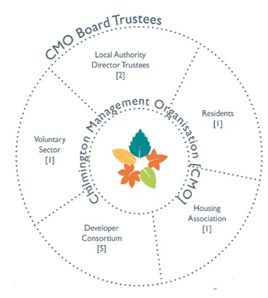
CMO Board – Governance was recommended within the S106 Agreement
Non Developer Trustees 5
Ben Lockwood – CMO Chairman & KCC Nomination
Alison Breese – Housing Association
Neil Shorter – Voluntary Sector
Steve Bartlet – Resident Trustee
Cllr Jessamy Blanford ABC
Developer Trustees – 5
Hodson Developments 2 nominations
Jarvis Homes 1 nomination
BDW 1 nomination
Chelmden Ltd,1 nomination
All members of the Board are volunteers and receive no payment for the time spent on CMO activities

Slide 7
Board Responsibilities
Oversees two accounts, CMO Charity Account, RCD Ringfenced Trust Account
Duties of the Trustees:
Ensure proper stewardship and financial responsibilities are carried out inline with the Charities Commission and the Companies Articles of Association
The income and property of the Company must be applied solely towards promoting the Objects and Articles of the Charity.
No part may be paid or transferred directly or indirectly by dividend bonus or profit to a Company Member; and a Director may not directly or indirectly receive any payment of money or benefit from the Company.

Slide 8
CMO Charity Account
Funding used for:
Community Development and other support to residents
Running of the administrative side of the Charity
Annual Accounts
Holding an AGM
Legal costs for challenges to RCD/ Changes to Statue/General Advice
Accounts filed at Charity Commission and Companies House
Funded by Developer Contributions through the S106 Agreement at triggers of every 500 occupations.

Slide 9
Charity Accounts
INCOME | 2025-26 £
Investment income | 1,728
Other income | 48,114
Total | 49,842
EXPENDITURE
Other | 79,808
NET INCOME/(EXPENDITURE) | -29,966

Slide 10
Income Breakdown
Income breakdown | £
Deposit account interest | 1,728
Reimbursement Legal Fees (inc S106 funds) | 2,358
Recharge Staff Costs for Stewardship | 45,000
Cabin hire | 756
 | 49,842

Slide 11
Expenditure Breakdown
Expenditure | £
Accountancy fee & Bookkeeping | 1,907 | McCade Ford Williams and Bookkeeper
AGM and Sundry costs | 916 | Hire Marquee AGM Sept 25
Computer Costs | 792 | Office 365 and Quickbooks
Play Equipment | 1,014 | Play equipment for the Cabin Garden
Office Equipment | 360 | table & chairs
Legal & Professional fees | 10,187 | Compliance Certificates Renters Reform Act, Framework Agreement Advice following Hodson Administration,
Community Activities | 2,936 | Easter costs of eggs/printing. Christmas Trees AGM expenses printing, replacement keys
Other Professional Services | 1,440 | Clearance of reeds from Lakes SUD
Service Agreement Staff Costs and other services | 60,000 | 2 Pt time staff, HR & IT support
Website | 257 | Website Domain Renewal
 | 79,808

Slide 12
Reserves | Unrestricted £ | Restricted £ | Total £
B/f 1 April 2025 | 160,428 | 2,120 | 162,548
Deficit 2025/26 | -29,966 |  | -29,966
Balance 31 March 2026 | 130,462 | 2,120 | 132,582
Questions and Vote on Charity Accounts
Vote is that the accounts reflect a true reflection of income and expenditure

Slide 13
Appointment of Independent Examiner
Mc Cade Ford William
Independent examiners remuneration - examination and accountancy fee
2026 : £1,907
2025 : £1,672
Vote to approve re-appointment for 2027

Slide 14
Trust Account – RCD funds
The original amount for Rent Charge Deed 1 was set in the S106 Business Plan in 2017.
It is a site wide charge.
It came into effect in 2019 on the first occupations.
RCD charges are increased from their based line by January RPI each year and are capped at this amount.
From 2023/24 residents have been charged under the cap.
The rent charge monies are held in a ring fenced fund.
This funding can only be used for the purposes defined on the Rent Charge Deeds and only within the area of the plan.

Slide 15
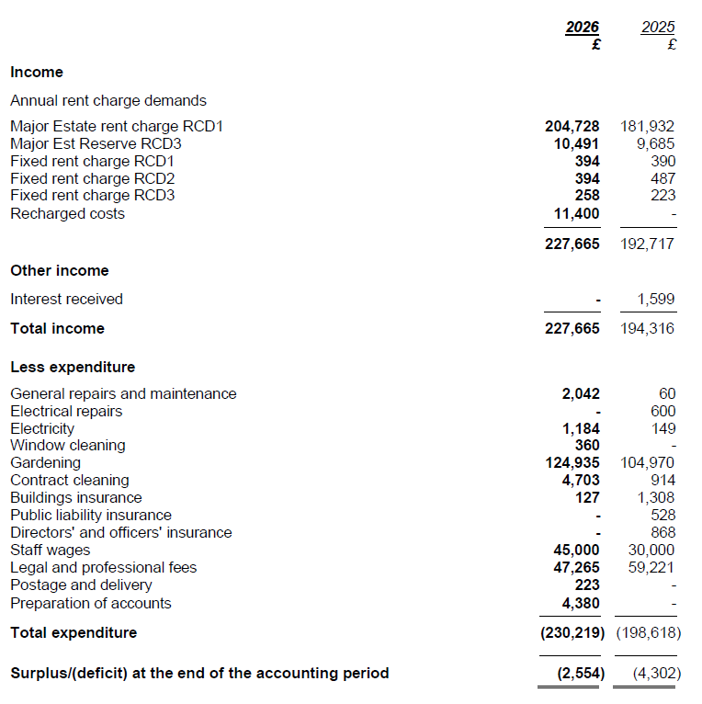
Trust account I&E Year end 31 March 2026

Slide 16
Trust Account Expenditure as a Graph

Slide 17
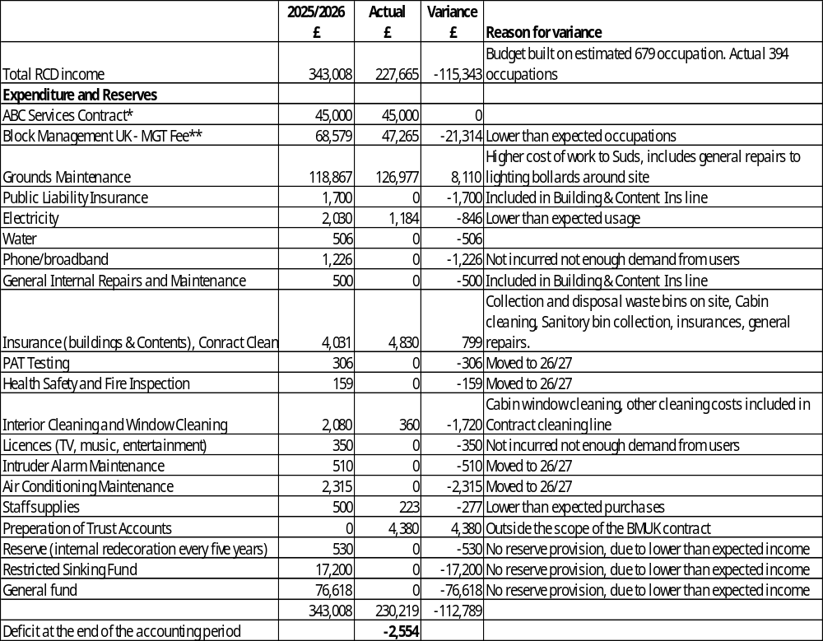
Final Accounts Compared to Budgeted

Slide 18
ABC Services Contract
34 hours of staff time, includes all salary oncosts (training, pension, insurances)
Office accommodation & stationery
Printing costs
IT equipment and software licences (Microsoft)
Access to specialist advice; communications/graphic designers/insurance/H&S/HR/data protection
Postage

Slide 19
BMUK Contract: Joshua Edgar
An appointed full-time Senior Property Manager (site surveys/report monitoring/contractor procurement).
Competently certified MTPI (Member of the Property Institute) & RICS (Associate of the Royal Institute of Chartered Surveyors).
Access to specialist advice; H&S (site)/enforcement, land handovers
24/7 fault reporting/tracking system
Out of hours emergency contact telephone number
Accounts team & system; setting up accounts/billing/debt collection
Staffing resilience, an accounts team works on CG, not an individual, other property managers have knowledge of CG in Joshua Edgar’s absence

Slide 20
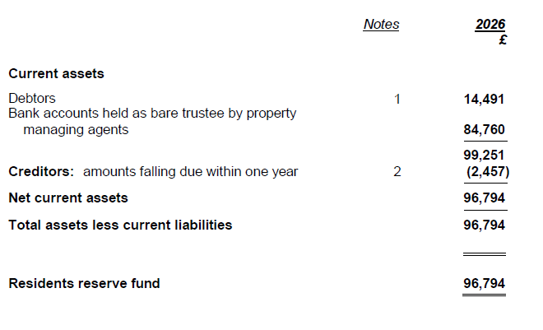
Trust Fund Reserve 31 March 2026

Slide 21
Budget 2026/27
RCD 1 Budget 2026/2027 | £
 | 2026/27
Total RCD Income | 342,901 | Based on 651 occupations. Current occupation 430 Sept 26
Expenditure and Reserves
ABC Services Contract* | -45,000
Block Management UK - MGT Fee** | -65,751
Grounds Maintenance | -192,954
Public Liability Insurance | -1,700
Premises costs
Electricity | -2,030
Water | -506
Phone/broadband | -1,226
General Internal Repairs and Maintenance | -500
Insurance (buildings & Contents) | -4,031
PAT Testing | -306
Health Safety and Fire Inspection | -159
Interior Cleaning and Window Cleaning | -2,080
Licences (TV, music, entertainment) | -350
Intruder Alarm Maintenance | -510
Air Conditioning Maintenance | -2,315
Staff supplies | -500
Reserve (internal redecoration every five years) | -530
Restricted Sinking Fund | -16,022
General fund | -6,430
 | -342,901

